Slide 1
The New IRC §7702
Mere Revision or Major Revolution?
Agenda
Description of the new 7702
Rationale behind the first change to this tax code provision in decades
Affect on current & future policies
Impact of 7702 on life insurance funding strategies/selling opportunities
Brought exclusively to NAIFA
Memphis/West TN by Ameritas
February 16th, 2021
Notes:
Introduction

Slide 2
Disclosures
Guarantees are based on the claims-paying ability of the issuing company.
Ameritas Growth Index Universal Life (form 3022) and Ameritas Value Plus Index Universal Life (form 3024) are issued by Ameritas Life Insurance Corp. is issued by Ameritas Life Insurance Corp. In New York, Ameritas Growth Index Universal Life (form 5022) and Ameritas Value Plus Index Universal Life (form 5024) are issued by Ameritas Life Insurance Corp. of New York. Policy and riders may vary and may not be available in all states.
The index options are not securities; you are not investing in stocks or in the indexes themselves. Therefore, credited interest does not include dividends paid by companies included in the relevant index. The index options may not be available in all states. The credited interest rate is linked, in part, to gains in any combination of indexes. Keep in mind, you are not actually participating in the market or investing in any stock or bond.
The information presented here is not intended as tax or other legal advice. For application of this information to your specific situation, please consult an attorney.
Standard & Poor’s 500™ Index is comprised of 500 stocks representing major U.S. industrial sectors. S&P 500® and Standard & Poor’s 500™ are trademarks of Standard & Poor’s and have been licensed for use by Ameritas Life Insurance Corp. This product is not sponsored, endorsed, sold or promoted by Standard & Poor’s and Standard & Poor’s does not make any representation regarding the advisability of investing in the Product.
The Russell 2000® Index is a trademark of the Russell Investment Group (“Russell”) and has been licensed for use by Ameritas Life Insurance Corp. This product is not sponsored, endorsed, sold or promoted by Russell and Russell makes no representation regarding the advisability of purchasing the product. Russell Investment Group is the source and owner of the trademarks, service marks and copyrights related to the Russell Indexes. Russell® is a trademark of Russell Investment Group.
The MSCI EAFE® is a service mark of MSCI and has been licensed for use by Ameritas Life Insurance Corp. Ameritas index annuity products are not sponsored, endorsed, sold or promoted by MSCI and MSCI makes no representation regarding the advisability of purchasing the product. The product contract contains a more detailed description of the limited relationship MSCI has with Ameritas Life Insurance Corp.
The BNP Paribas Momentum Multi-Asset 5 Index (BNPP Momentum 5 Index) is a new index (launched on 1/27/2017) with limited historical information. For more information about the BNPP Momentum 5 Index, visit https://momentum5index.bnpparibas.com. This product is not sponsored, endorsed, sold or promoted by BNP Paribas or any of its affiliates (collectively, “BNP Paribas”). Neither BNP Paribas nor any other party (including without limitation any calculation agents or data providers) makes any representation or warranty, express or implied, regarding the advisability of purchasing this product. BNP Paribas Momentum Multi-Asset 5 Index (the “Index”) is the exclusive property of BNP Paribas. BNP Paribas and the Index are service marks of BNP Paribas and will be licensed for use for certain purposes by Ameritas Life Insurance Corp. Neither BNP Paribas nor any other party has or will have any obligation or liability to owners of this product in connection with the administration or marketing of this product, and neither BNP Paribas nor any other party guarantees the accuracy and/or the completeness of the Index or any data included therein.
This information is provided by Ameritas®, which is a marketing name for subsidiaries of Ameritas Mutual Holding Company, including, but not limited to, Ameritas Life Insurance Corp., located at 5900 O Street, Lincoln, NE 68510, and Ameritas Life Insurance Corp. of New York, located at 1350 Broadway, Suite 2201, New York, NY 10018. Ameritas Life Insurance Corp. of New York is licensed in New York. Each company is solely responsible for its own financial condition and contractual obligations. For more information about Ameritas®, visit ameritas.com.
Ameritas® and the bison are registered service marks of Ameritas Life Insurance Corp. Fulfilling life® is a registered service mark of affiliate Ameritas Holding Company.
© 2020 Ameritas Mutual Holding Company

Slide 3
Kelly Halverson, VP and Actuary Individual Product Development
Andrew Rinn, VP Advanced Markets and Case & Competition Design

Slide 4
Welcome

Slide 5
7702
Notes:
Can we demo this?

Slide 6
7702 Changes
In late December, Congress passed, and the President signed the “Consolidated Appropriations Act, 2021”, which includes provisions changing the interest rates used in Section 7702 of the U.S. IRS Tax Code
The fixed 4% GLP, 6% GSP, and MEC rates have been restated as variable rates equal to the greater of the applicable minimum rate and the rate(s) guaranteed in the contract at issue
The current applicable rate for GLP will be 2% and GSP will be 4%
MEC rates point to the rates in 7702 as well
Why is this a big deal?
Example: Male, Issue Age 45,
Preferred NT, $1M Initial DB,
Sample IUL
Basis | Old 7702 | New 7702 | % Change
2001 CSO MEC | $48,002
2017 CSO MEC | $42,611 | $75,676 | +78%
GLP | $42,838 | $67,596 | +58%
GSP | $200,322 | $578,431 | +189%
Notes:
Andrew will discuss here and we will do a screen share of his FAQ sheet.

Slide 7
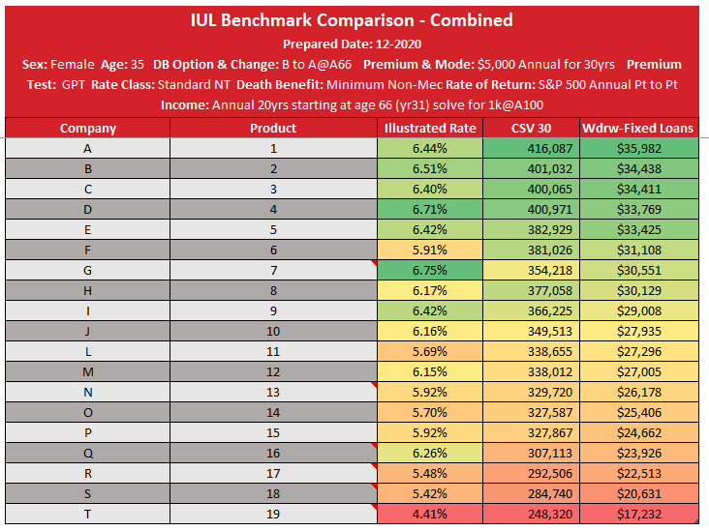
Sample IUL product benchmarking – Income Solves with 20K premium for 30 years
AG49A was effective on Dec 14th
What happens if some carriers adopt 7702 faster?
Will this impact both accumulation and protection products?

Slide 8
Technical Aspects of 7702 Changes
Types of Questions Carriers are Considering
  If I do a face increase to an older policy, will it recalculate on the new interest rates, buying more premium paying capacity?
  Once we do get system changes in, will we retroactively change the 2021 issues to the new basis? Will the company be reducing face amount on in-force 2021 issued business after the admin systems are updated?
  Impact on Whole Life Insurance
  Internal Replacements
  Compensation

Slide 9
Impact of 7702 on life insurance funding strategies/selling opportunities

Slide 10
Business and Transfer Tax Planning –
Split-Dollar Life Insurance
7702 changes cause clients to “overfund” life insurance
Impact on business, foreign national and retirement planning scenarios
Larger contributions to ILITs exceed annual gift tax exclusion
Split-dollar arrangements used to fund premiums instead

Slide 11
Questions
Thank you!

